Slide 1

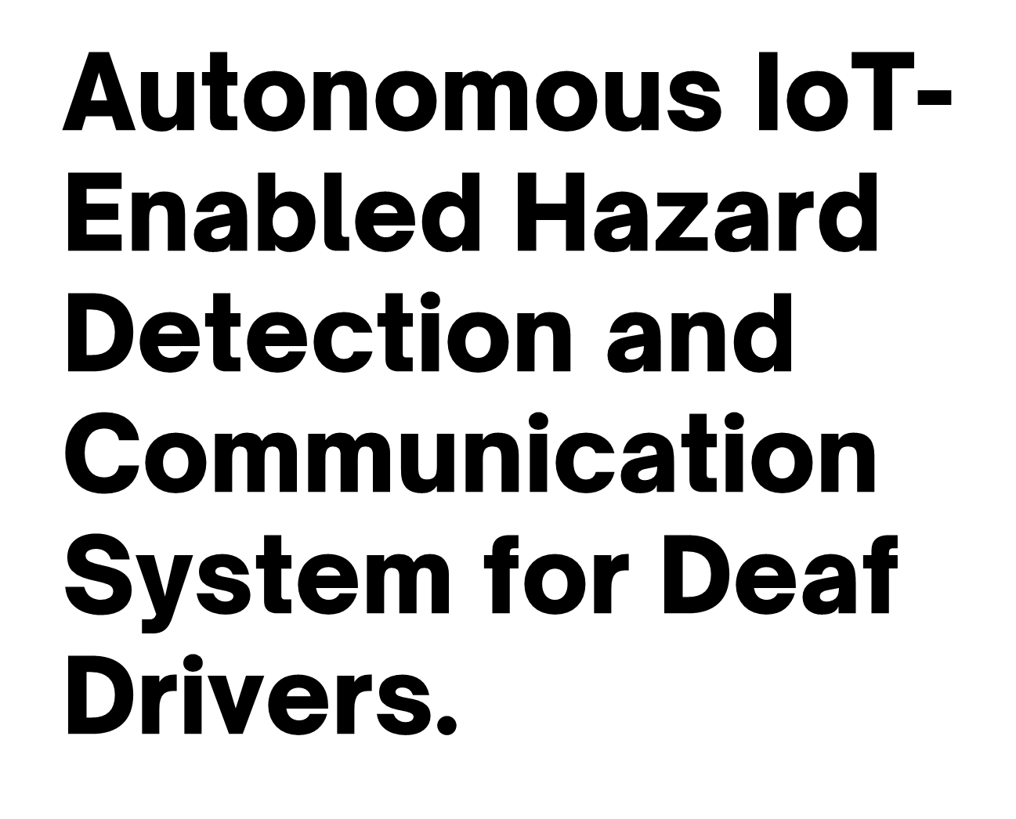


Slide 2

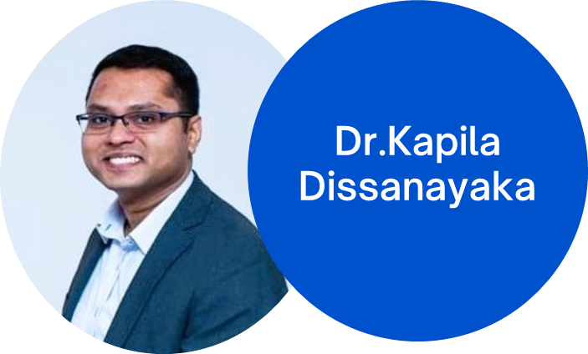

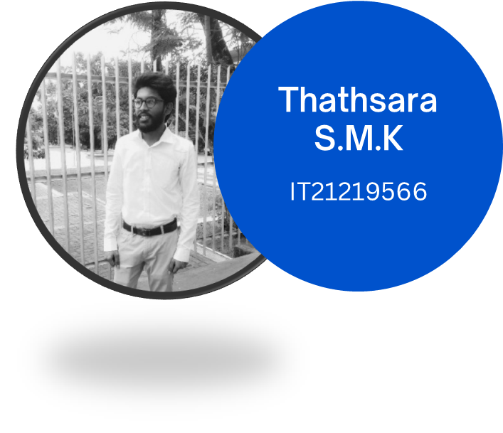
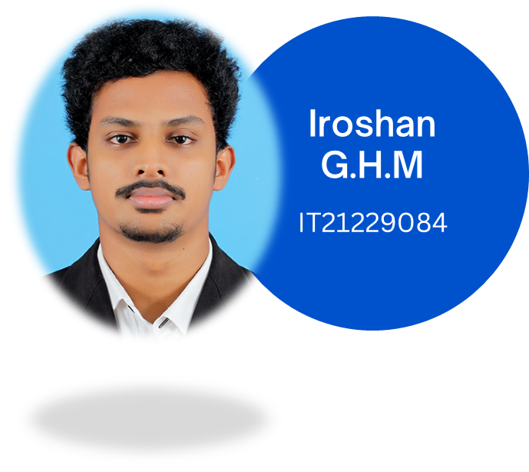


(Supervisor)
(Co-Supervisor)

Slide 3


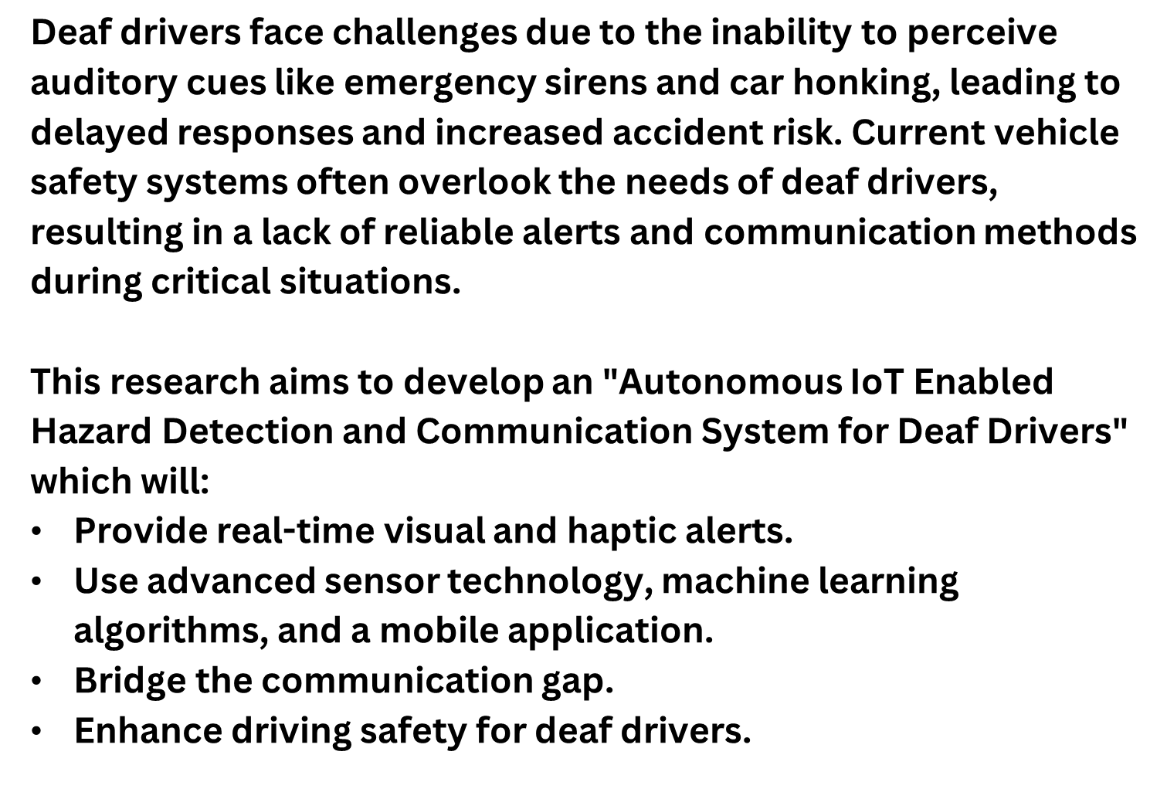

Slide 4


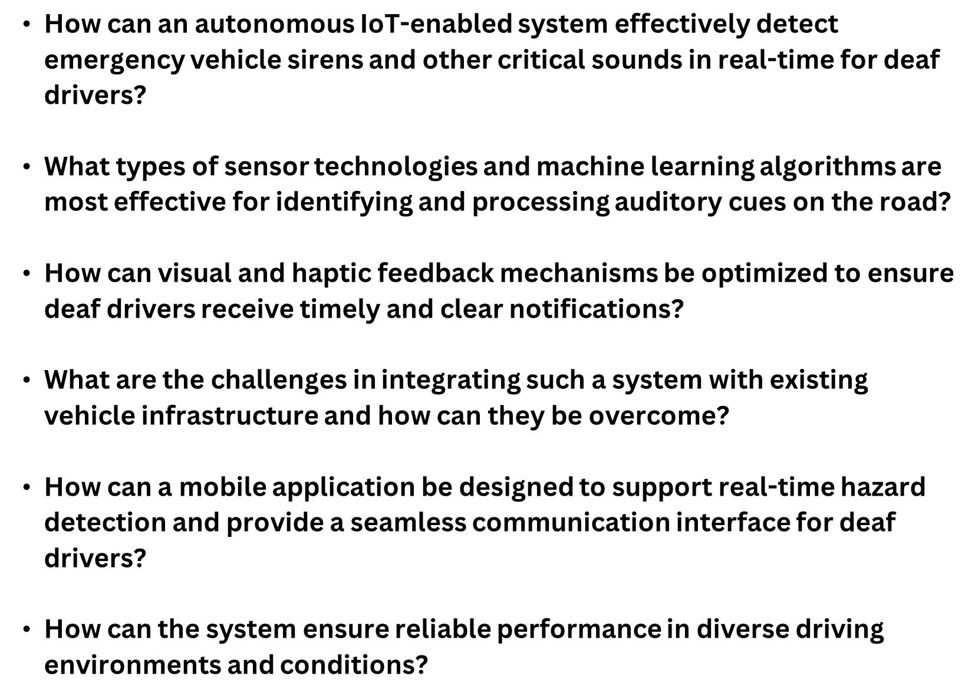

Slide 5







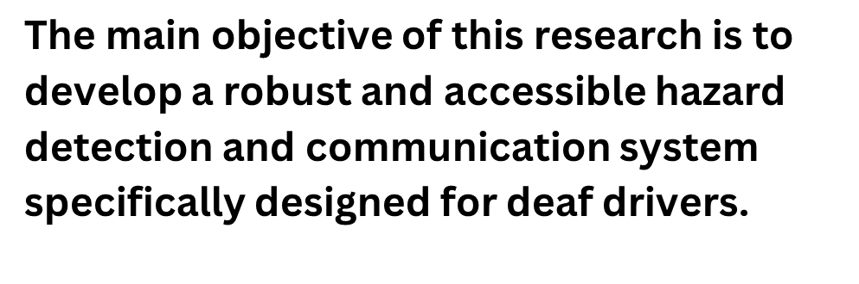


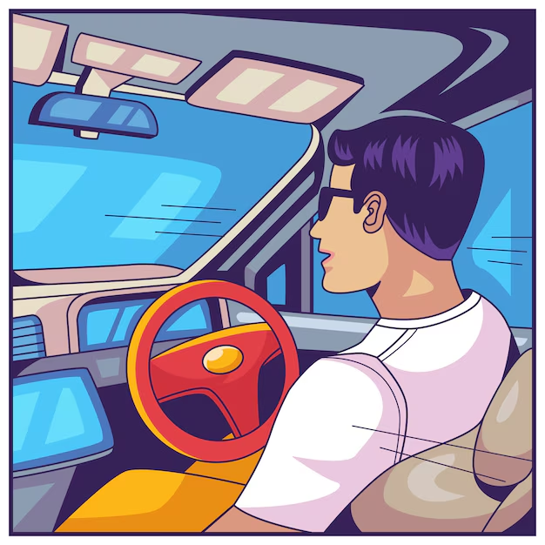




Slide 6



IT21388316 | Rathnayake R.M.S.N | 24-25J-132

Slide 7
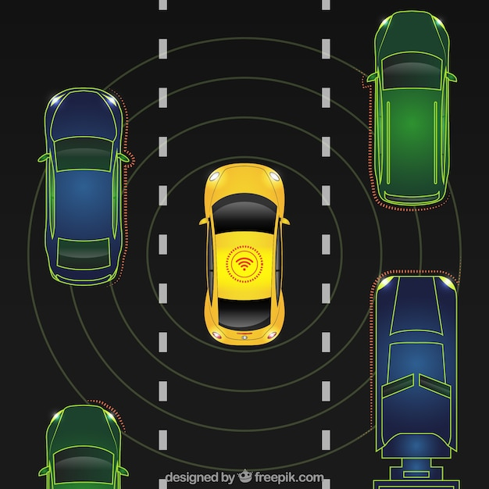
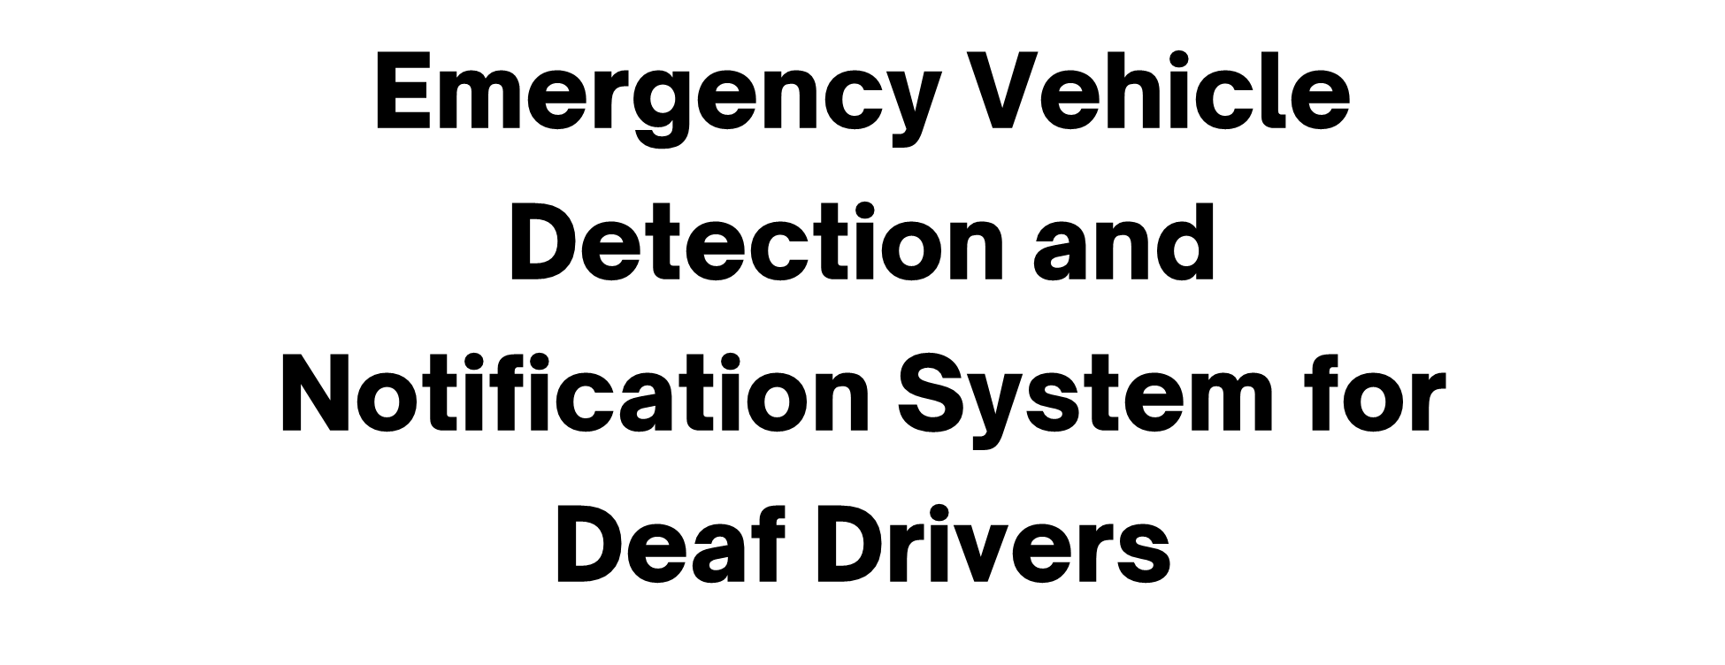
IT21388316 | Rathnayake R.M.S.N | 24-25J-132

Slide 8

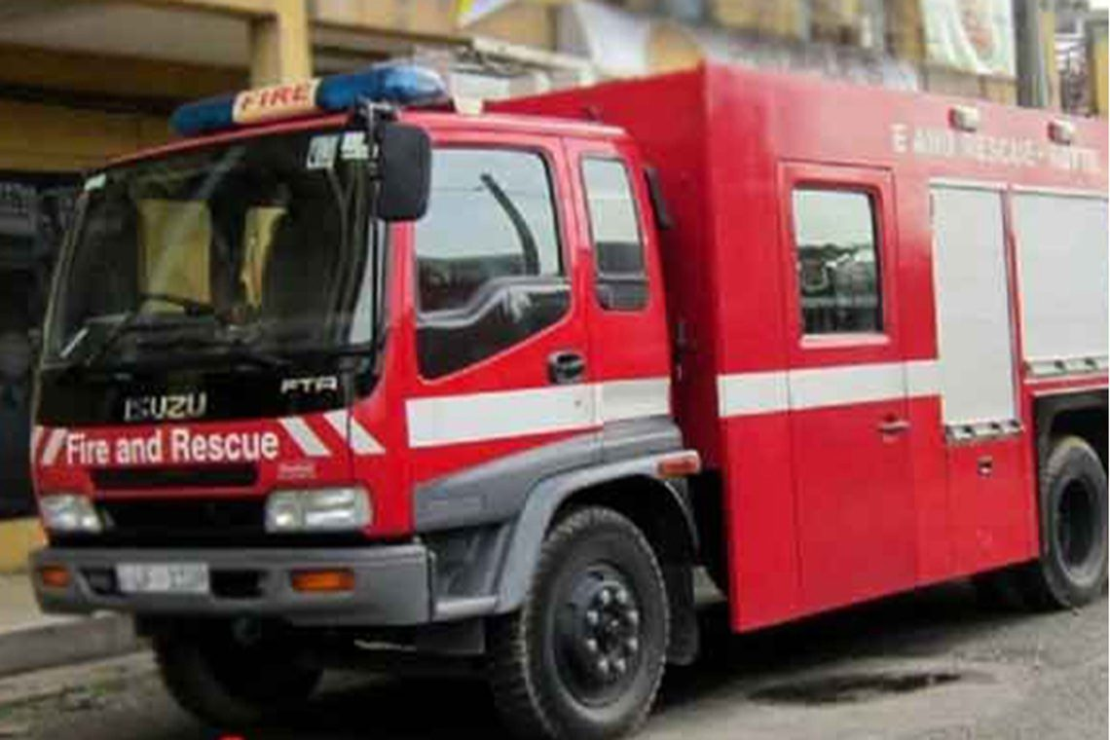
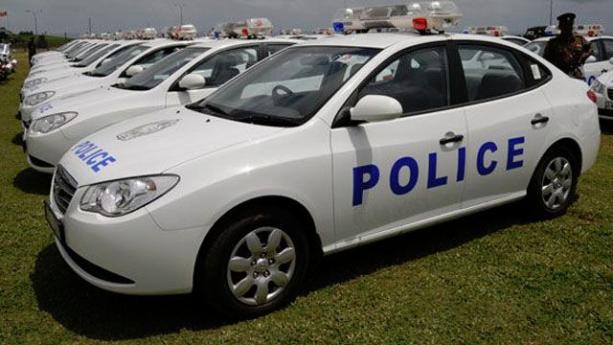
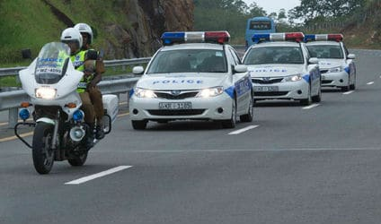
IT21388316 | Rathnayake R.M.S.N | 24-25J-132

Slide 9


How can we develop an effective system to detect and notify deaf drivers of approaching emergency vehicles using advanced sound recognition and real-time alert mechanism?
what are the optimal configurations for a high-sensitive MEMS microphone array to accurately capture emergency vehicle siren sounds amidst traffic noise?
What are the most effective microcontrollers for real-time signal processing and detection in a mobile vehicular environment?
How can seamless and reliable communication be established between the detection unit and notification system via Bluetooth or WiFi modules?
IT21388316 | Rathnayake R.M.S.N | 24-25J-132

Slide 10
Completion and Future works
Completed Component
Future Implementation
1.Sound Capture.
Develop a high-sensitive MEMS microphone to capture sound from all directions.
2.Signal Processing.
Implement high-pass and band-pass filters to enhance siren signals.
3.Deep Learning.
Train a deep learning model to recognize various emergency vehicle siren patterns.
4.Signal Processing & Detection.
Utilize microprocessor to process audio signals and run detection algorithms.
5.Notification System.
Create visual alerts on mobile screens and develop haptic notifications through vibrating covers on the steering wheel.
6.Communication.
Establish communication between the detection unit and notification system via Bluetooth or WiFi modules.
IT21388316 | Rathnayake R.M.S.N | 24-25J-132

Slide 11
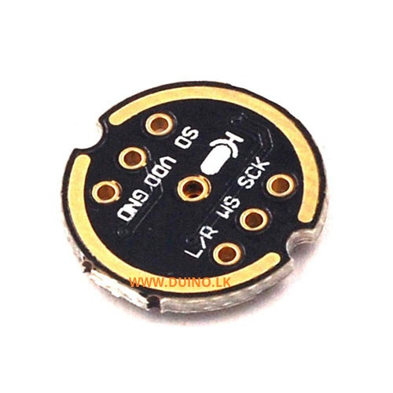
Sound Capture
The INMP441 provides high-quality audio input necessary for training and deploying AI model.
Its digital output and robust features make it a practical choice for automotive environments where reliability and precision are critical.
Its low power consumption and compact size allow seamless integration into the overall system, including deployment in edge AI devices within the vehicle.
INMP441 MEMS Microphone
IT21388316 | Rathnayake R.M.S.N | 24-25J-132

Slide 12
Edge Impulse VS Traditional Deep Learning Models
Aspect | Edge Impulse | Traditional Deep Learning Models
Target Platform | Optimized for resource-constrained edge devices (e.g., microcontrollers). | Designed for high-performance systems like GPUs or cloud environments.
Ease of Development | End-to-end platform: integrates data acquisition, preprocessing, training, and deployment in one environment. | Requires separate tools for preprocessing, model training, and deployment optimization.
Model Optimization | Automatically generates small, efficient models suitable for edge devices. | Requires manual optimization (e.g., pruning, quantization) for edge deployment.
Audio Signal Processing | Provides built-in tools like MFCC for feature extraction from audio signals. | Requires manual implementation or integration of audio preprocessing pipelines.
Latency | Real-time inference on the edge, without cloud dependency. | Cloud-based inference can introduce latency; local inference needs high-end hardware.
Power Consumption | Designed to run on low-power devices with minimal energy requirements. | Typically requires devices with higher power and energy demands.
Cost | Reduces costs by enabling on-device inference, minimizing cloud dependency. | Higher costs for cloud-based inference or high-performance hardware.
IT21388316 | Rathnayake R.M.S.N | 24-25J-132

Slide 13
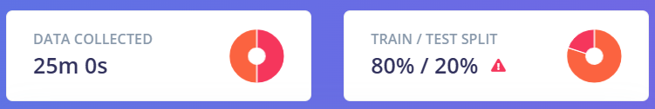
Sources of Audio Data
Pre-existing Datasets
UrbanSound8K: Contains environmental sound clips, including sirens.
Manual Collection
Emergency vehicles like ambulances, police cars, and fire trucks.
Different scenarios (urban, rural, heavy traffic).
Publicly Available Recordings
Extract sounds from YouTube videos.
IT21388316 | Rathnayake R.M.S.N | 24-25J-132

Slide 14
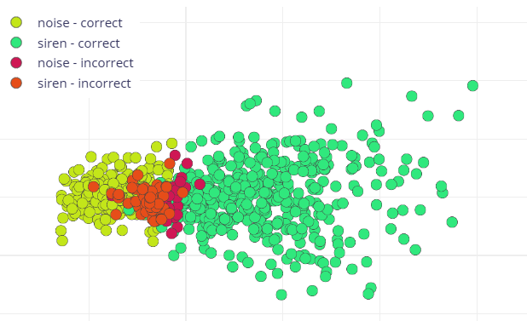

Deep Learning Model
Neural network architecture : CNN-based architecture.
Number of training cycles(epochs) : 300
Training processor : CPU
Add Data augmentation
IT21388316 | Rathnayake R.M.S.N | 24-25J-132

Slide 15
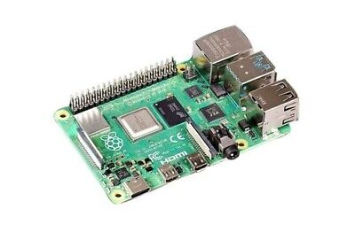

Edge Device
Why?????
Sufficient Processing Power
Handles real-time audio processing, feature extraction, and AI inference.
Raspberry Pi 4 model B 8GB
IT21388316 | Rathnayake R.M.S.N | 24-25J-132

Slide 16



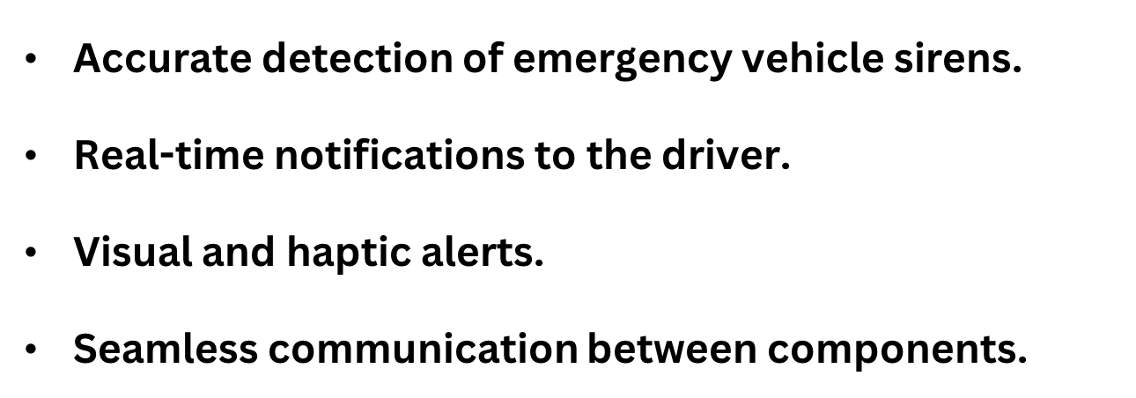
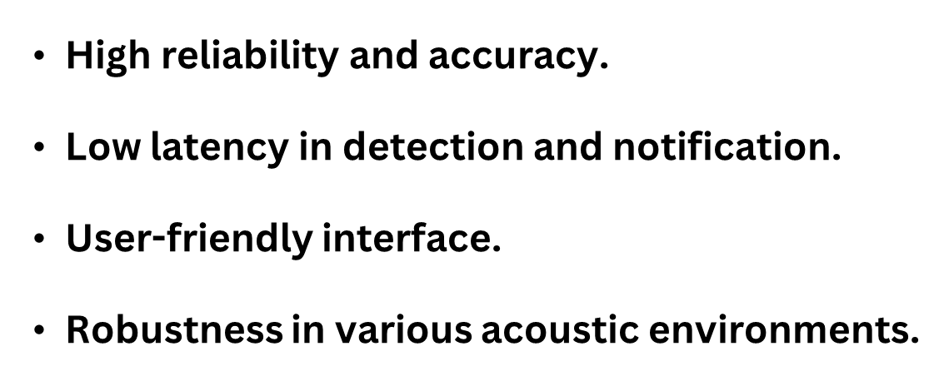

IT21388316 | Rathnayake R.M.S.N | 24-25J-132

Slide 17

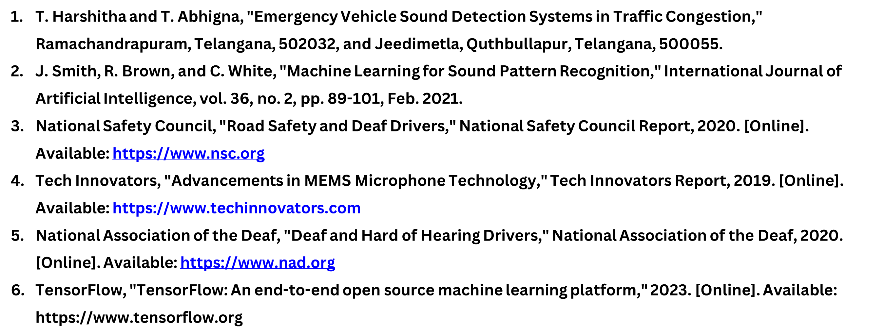
IT21388316 | Rathnayake R.M.S.N | 24-25J-132

Slide 18

Fernando W.T.R.P
IT21278280
Software Engineering
IT21278280 | Fernando W.T.R.P | 24-25J-132

Slide 19

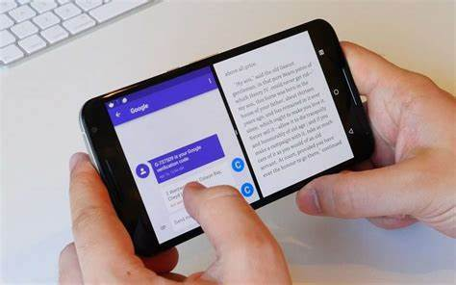
Continued Vehicle Horn Detection &
Alert System
IT21278280 | Fernando W.T.R.P | 24-25J-132

Slide 20

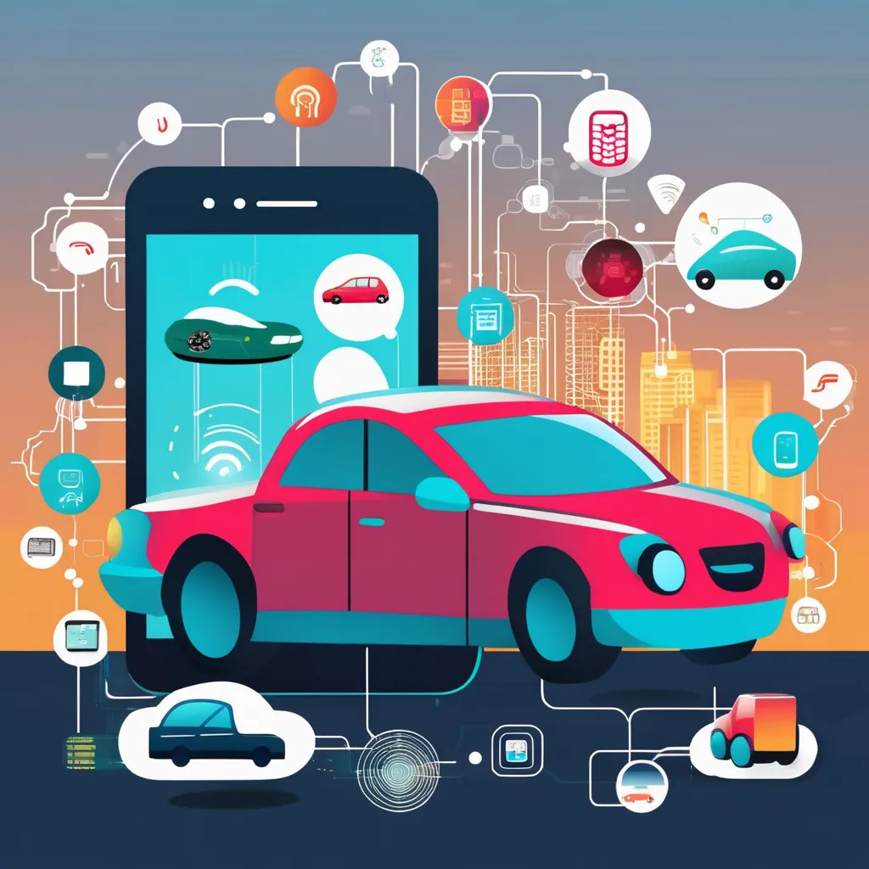
This system enhances situational awareness for deaf drivers by detecting and localizing vehicle horn sounds using IoT and machine learning. It transforms auditory signals into visual and tactile alerts, providing immediate feedback through a mobile app and vibrating steering wheel cover. This innovation addresses safety gaps for the hearing impaired and contributes to inclusive automotive technology.
IT21278280 | Fernando W.T.R.P | 24-25J-132

Slide 21

RESEARCH PROBLEM
What machine learning algorithms are most effective for classifying vehicle horn sounds in noisy urban environments?
How can an IoT-enabled system effectively detect and localize vehicle horn sounds to enhance situational awareness for deaf drivers?
Challenges in Designing Intuitive User Interfaces for Deaf Drivers
IT21278280 | Fernando W.T.R.P | 24-25J-132

Slide 22
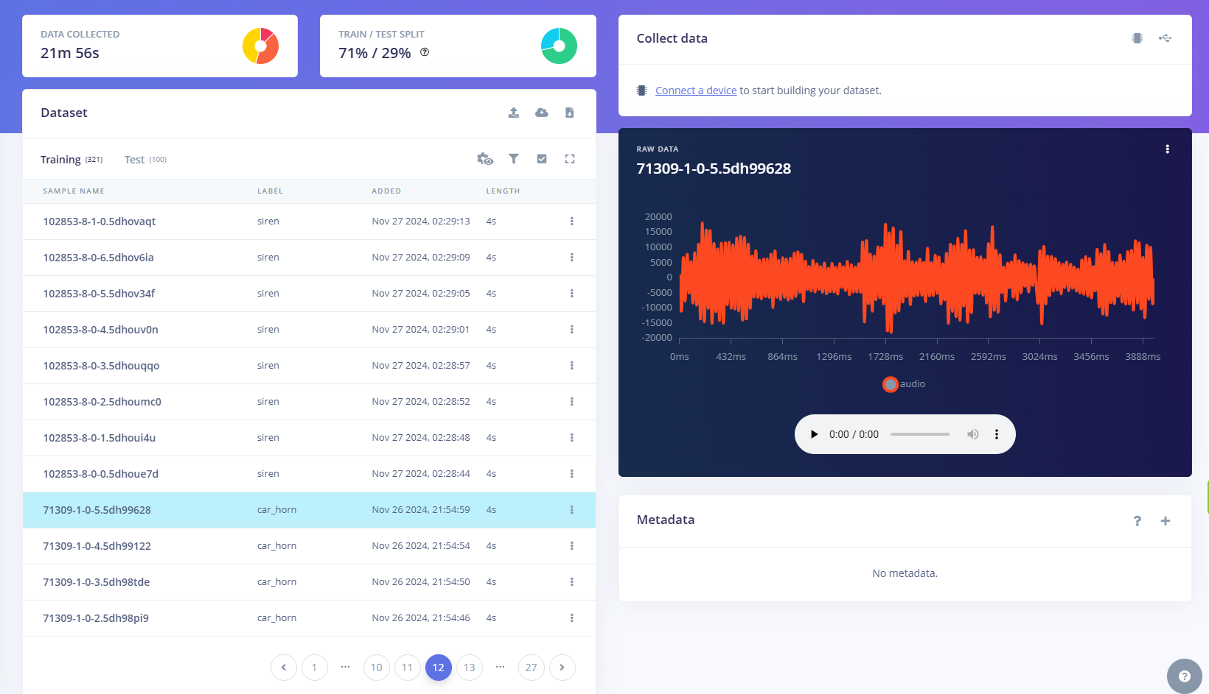
Data Acquisition
Types of data sets
UrbanSound8K
Publicly Available Recordings
Car Horns
Sirens
Background Noises

Slide 23
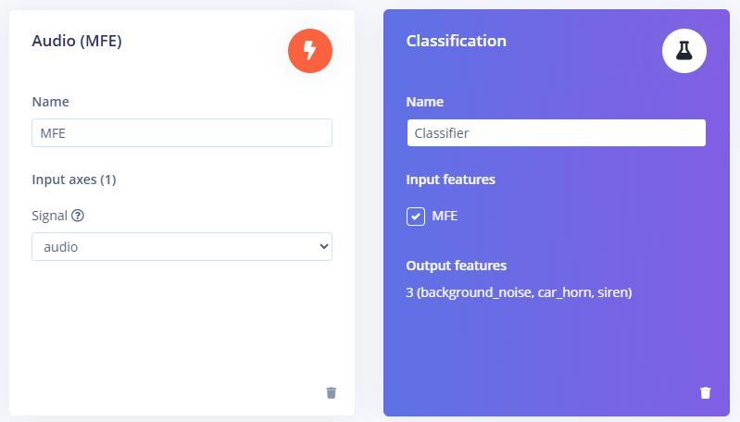
Data Preprocessing
MFE
Extracts a spectrogram from audio signals using Mel-filterbank energy features, great for non-voice audio.

Slide 24
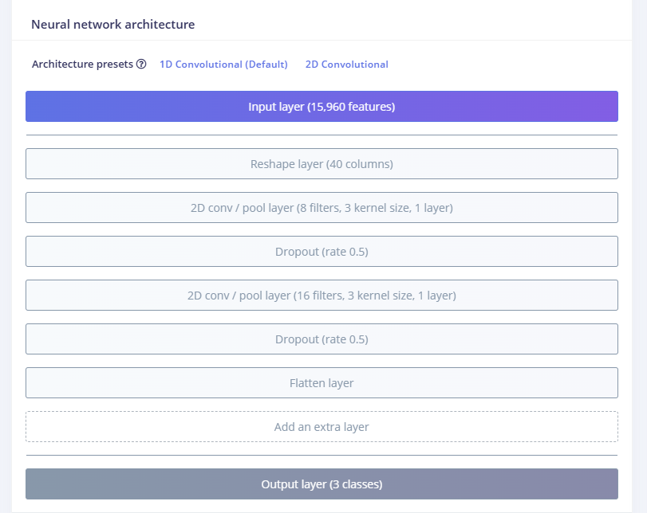
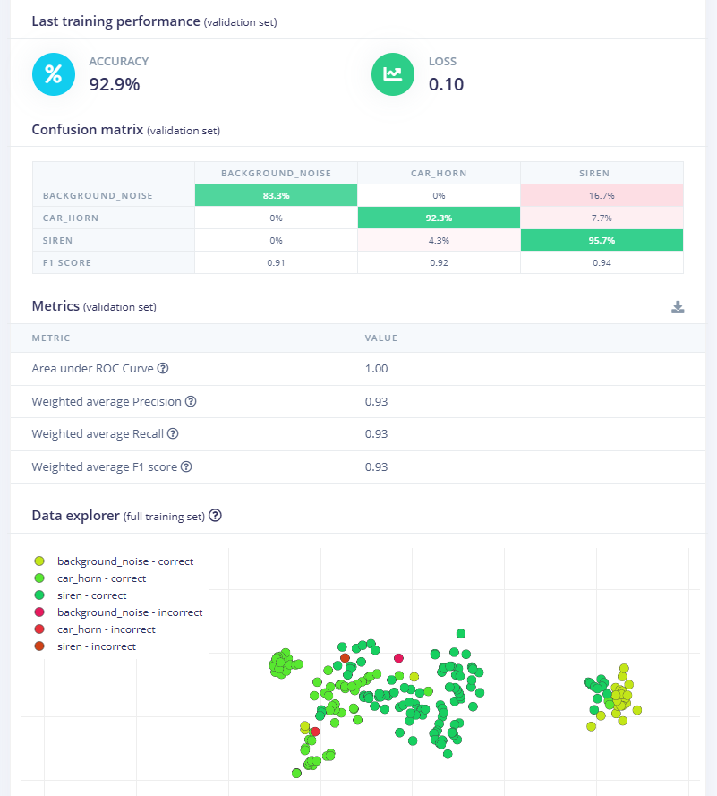
Data Classification

Slide 25
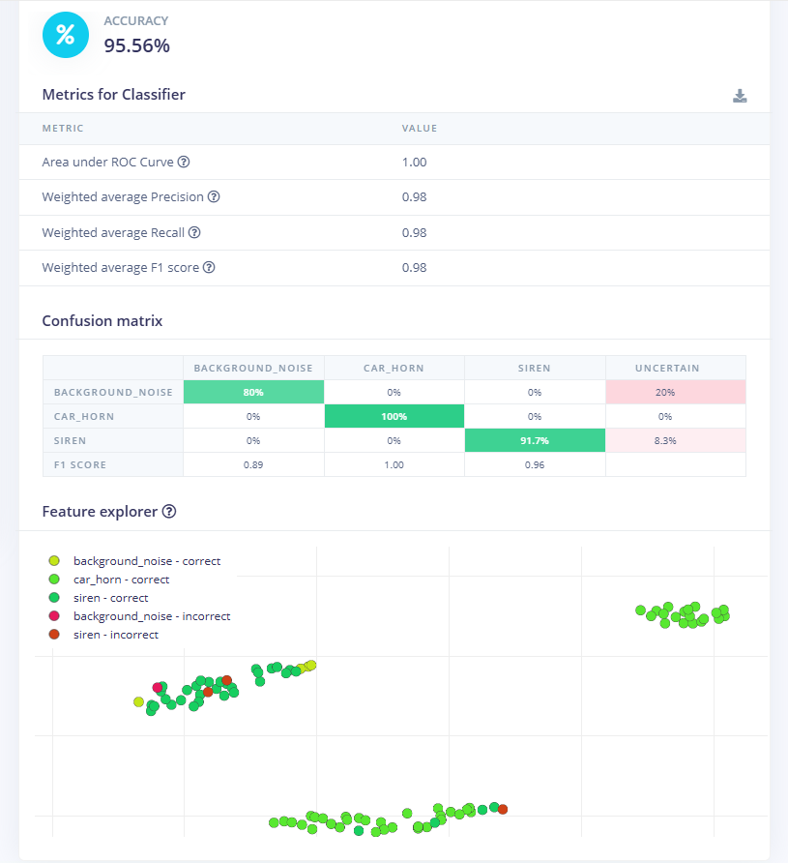
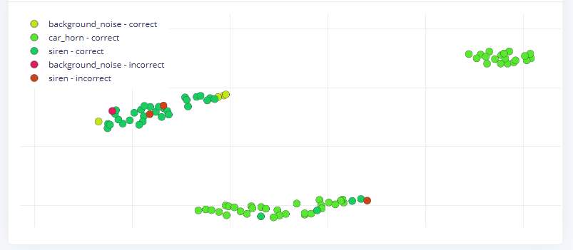
Model Testing
Accuracy – 95.56%

Slide 26
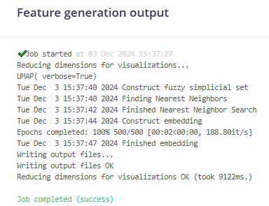
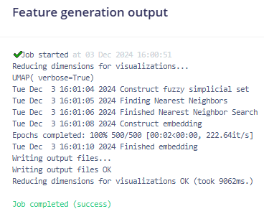
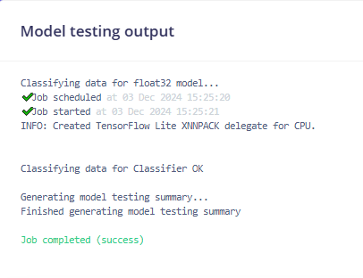
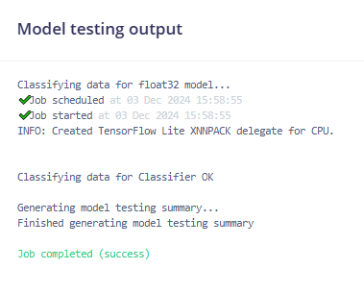
Select the best algorithm for the model with highest accuracy
Model 1
Model 2
Last Model
Accuracy – 75%
Accuracy – 95.56%
Accuracy – 42.22%

Slide 27

Completion and Future works
Completed Component
Future Implementation
Collect Audio datasets
2. Audio classification model
3. UI development
Enhance ML model
2. Develop Mobile App with all integrations
3. Testing, Evaluation & Maintenance

Slide 28

Horn Detection
Sound Localization
Real Time Alerts
Accuracy
Durability
User-Friendliness

Slide 29
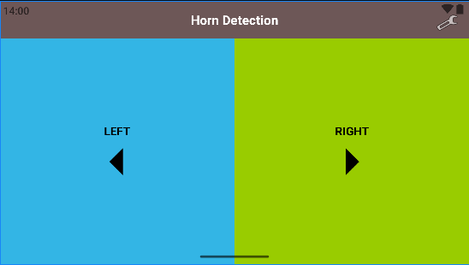
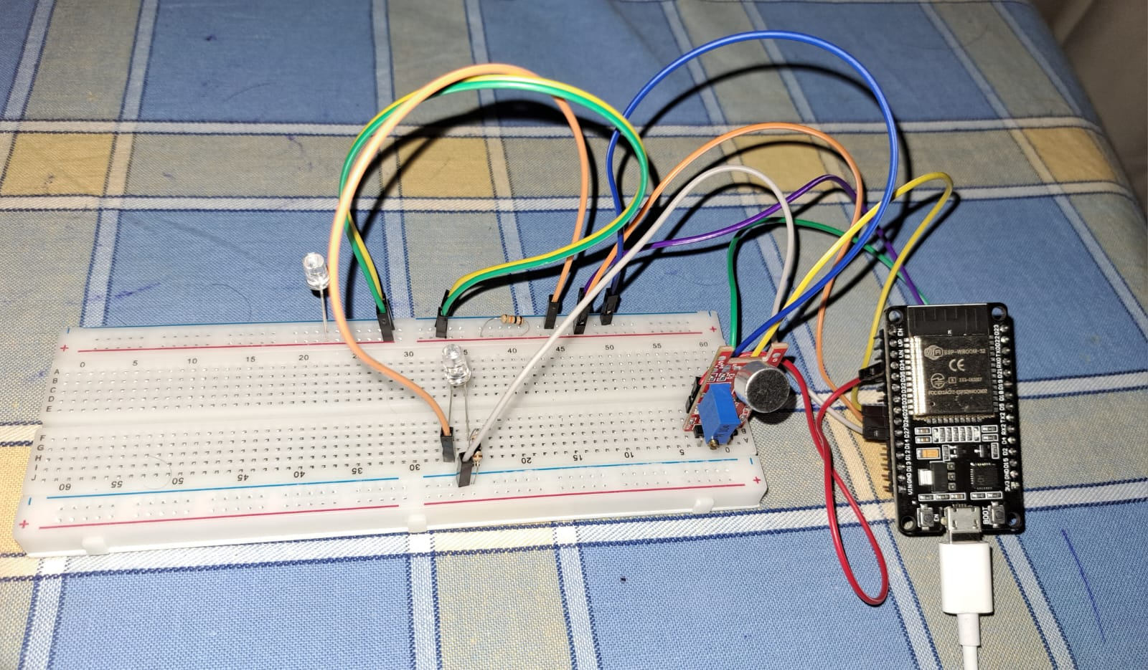
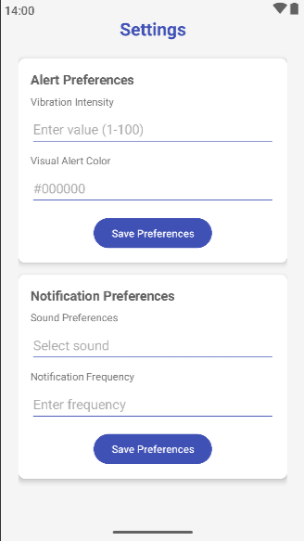
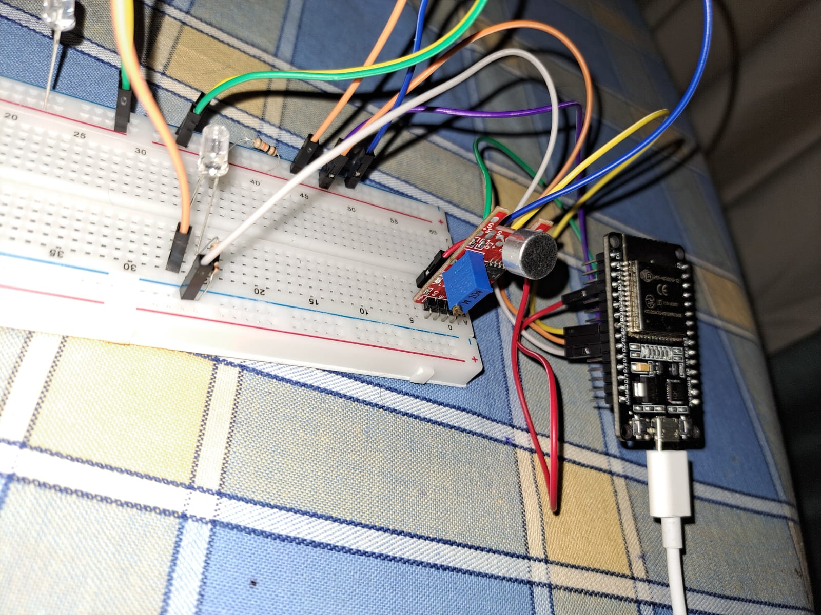
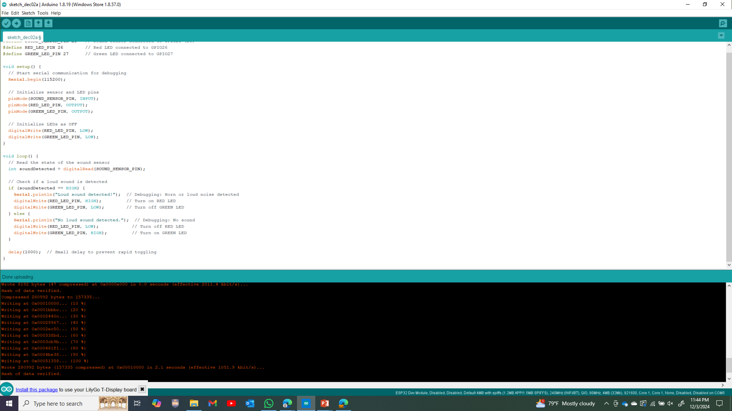
Progress of UI design & Circuit design testing
Split – Screen UI
Settings UI

Slide 30

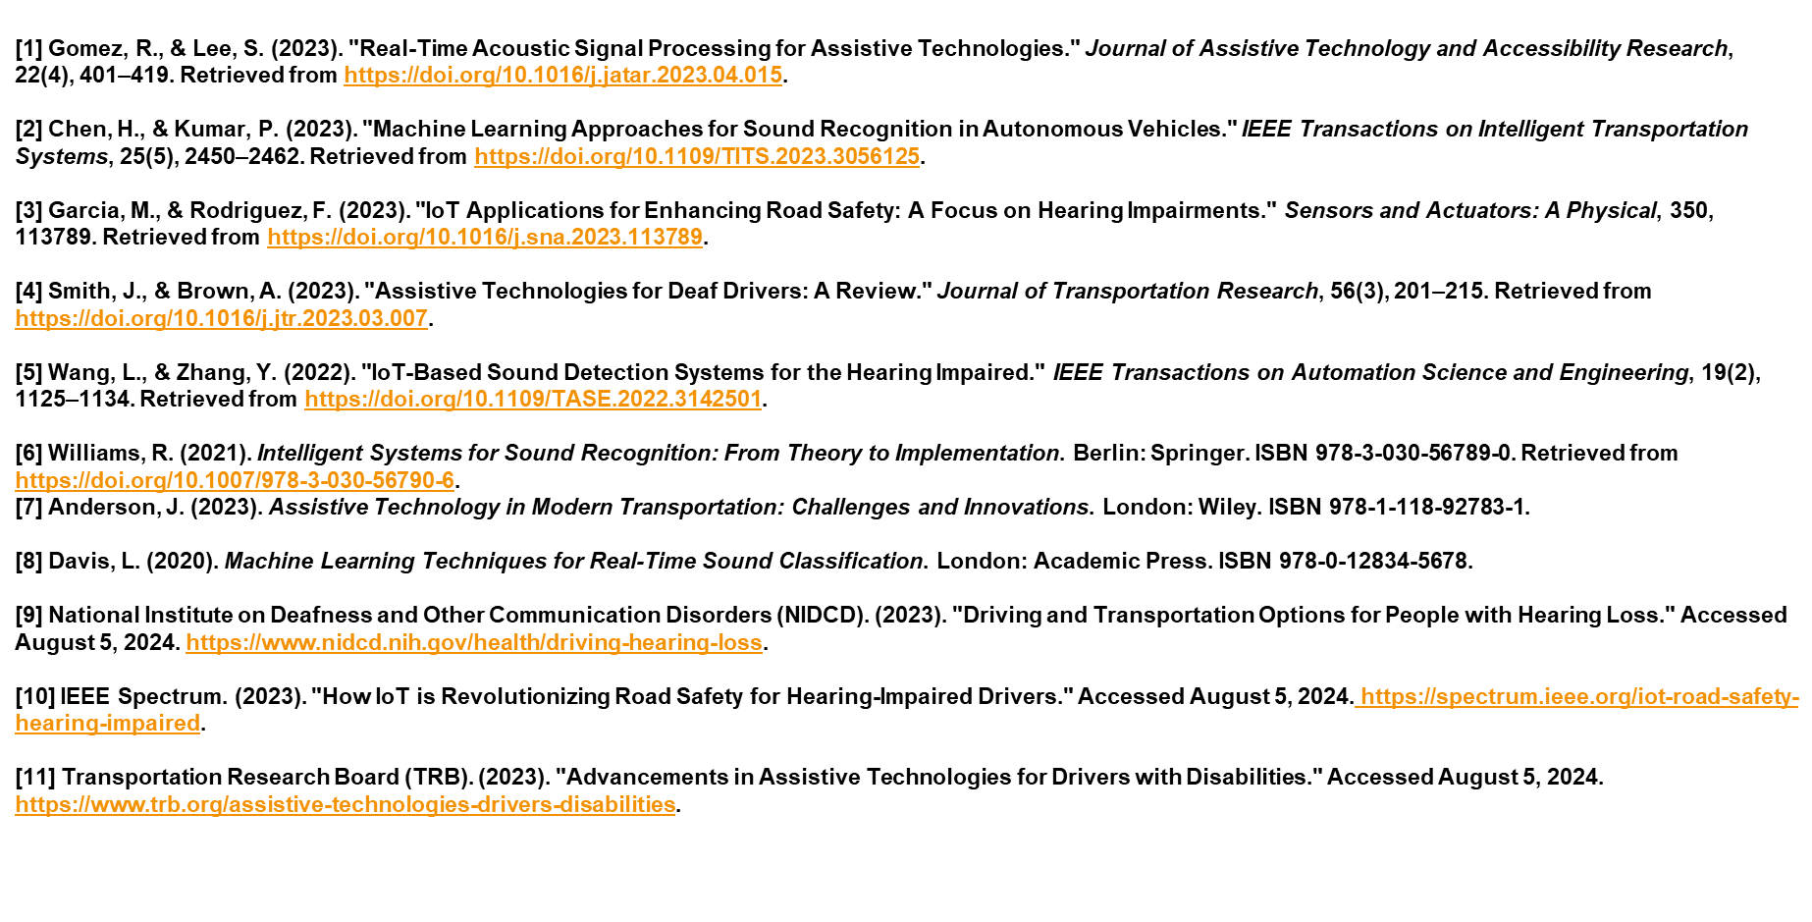

Slide 31

Thathsara S. M. K.
IT21219566
Software Engineering
IT21219566 | Thathsara S. M. K. | 24-25J-132

Slide 32
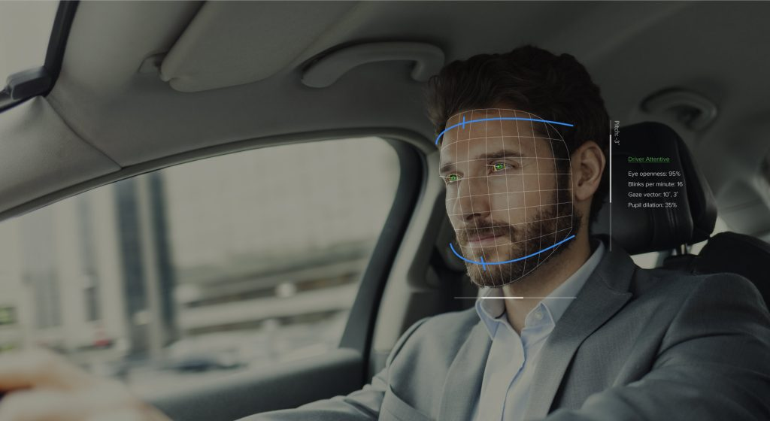
Comprehensive Driver Behavior Monitoring and Reporting System.
IT21219566 | Thathsara S. M. K. | 24-25J-132

Slide 33
Background
Multimodal Approaches in Driver Behavior Analysis:
CNN for Visual Inputs
Purpose: Process spatial information from video or image data.
Model Architecture: 3D-CNNs for video sequences to capture spatiotemporal features.
RNN for Temporal Sensor Data
Purpose: Handle sequential data such as time-series signals.
Model Architecture: LSTMs (Long Short-Term Memory) for long-range temporal dependencies.

Slide 34
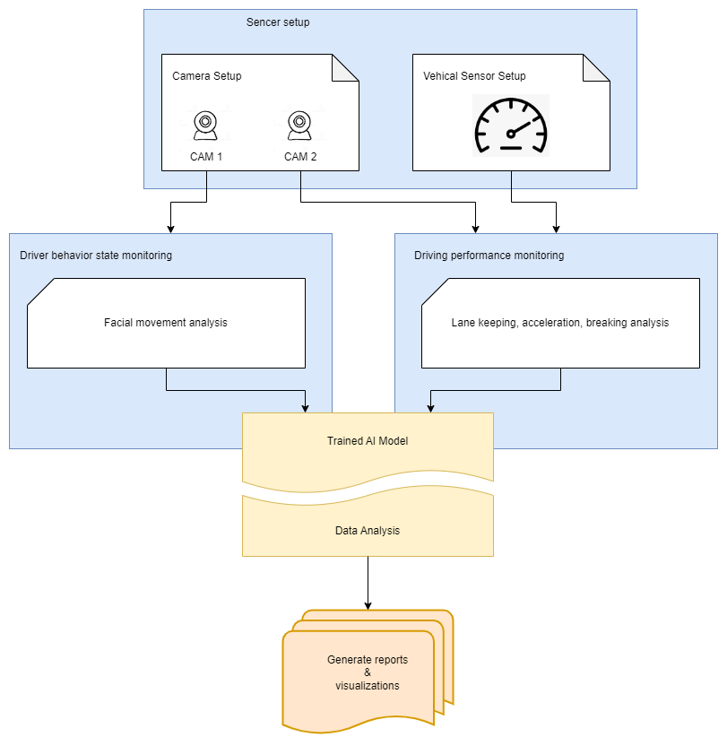
System Diagram

Slide 35
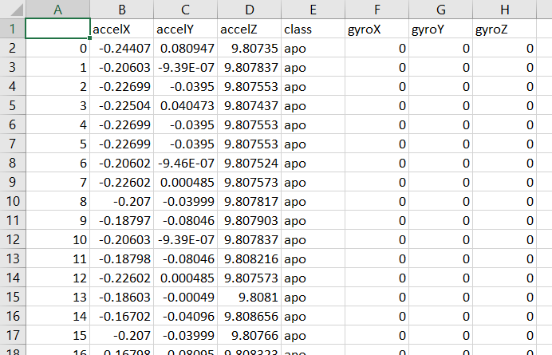
Data Collection
Driver behavior data was collected from Google, Kaggle.
https://www.kaggle.com/datasets/dasmehdixtr/carla-driver-behaviour-dataset/data

Slide 36
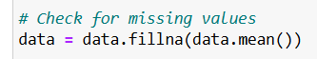
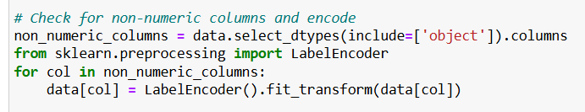
Data Preprocessing
Handling Missing Values
Missing values can interfere with model performance. This code replaces missing values with the column-wise mean.
Handling Non-Numeric Columns
Non-numeric columns (e.g., categorical data) need to be converted into numeric format for machine learning algorithms to process them. This is done using Label Encoding.

Slide 37
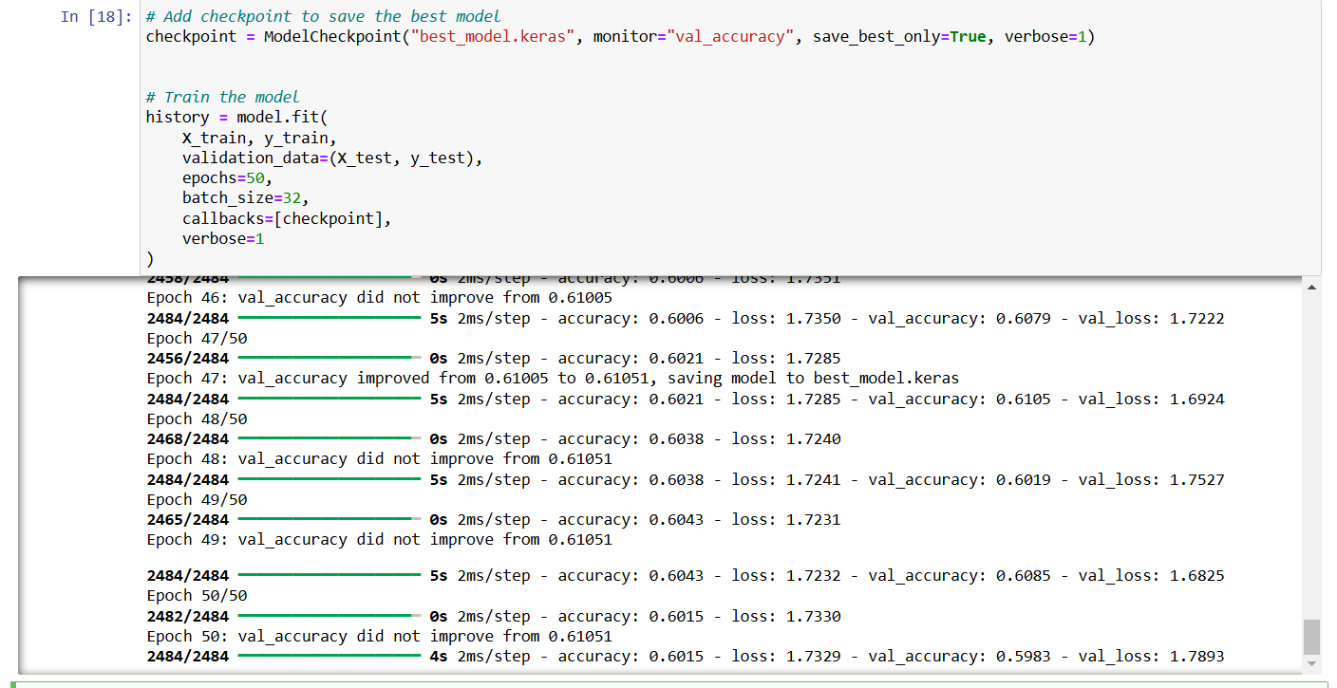
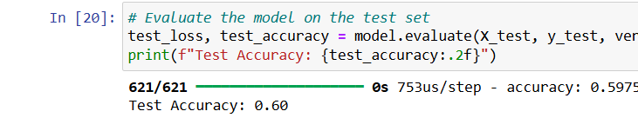
Model Creation Training
Test Accuracy: 60.00%

Slide 38
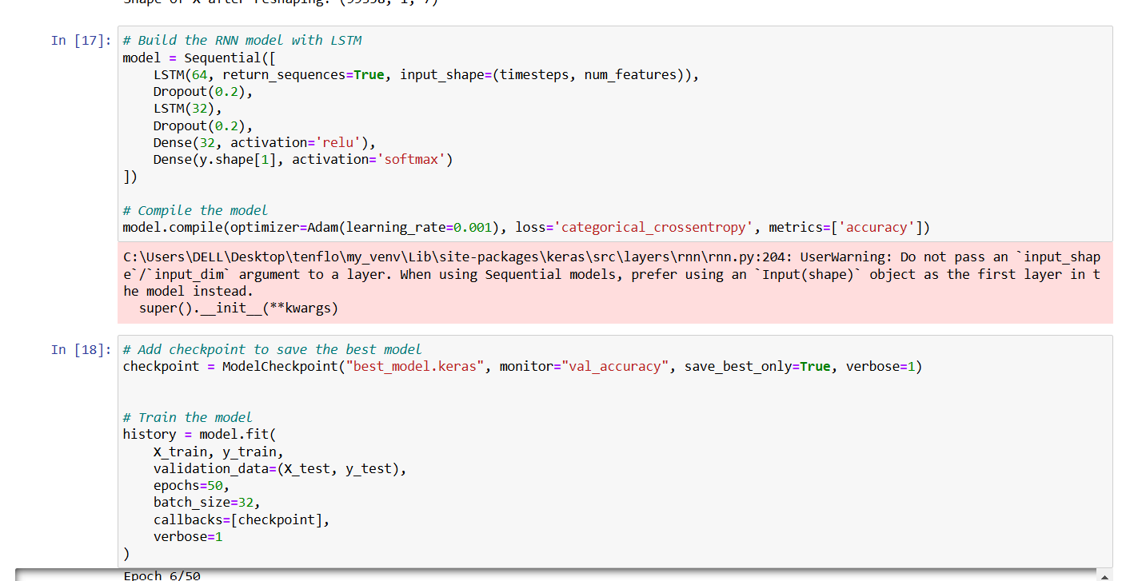
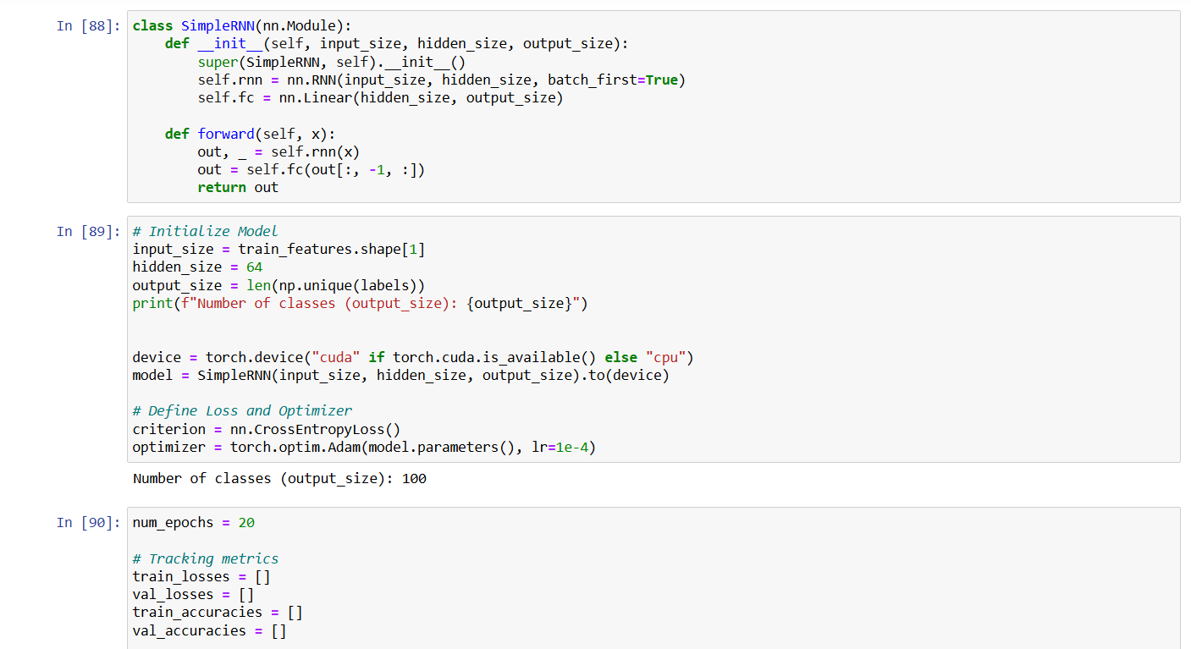
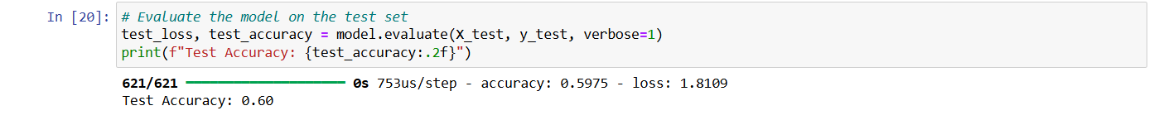
Select the best algorithm for the model with highest accuracy
First Model
Second Model
Test Accuracy: 76.05%
Test Accuracy: 60.00%

Slide 39
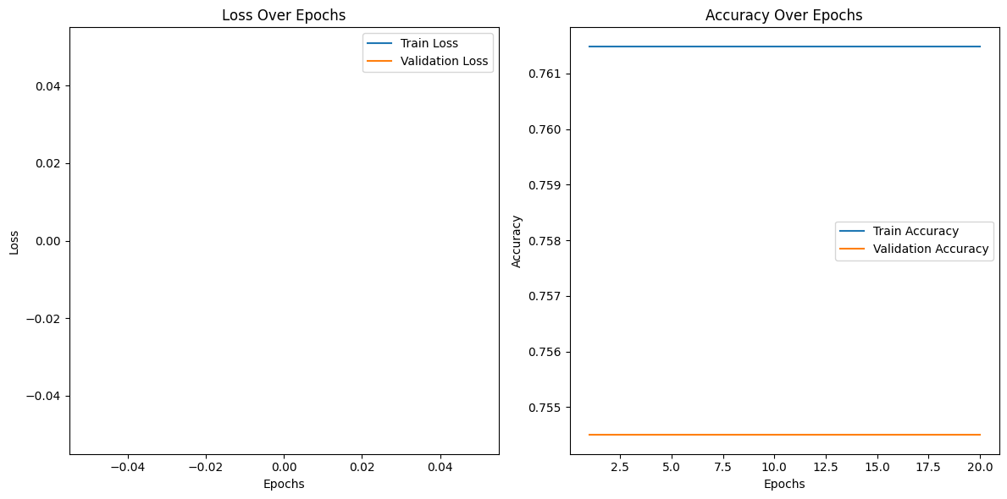
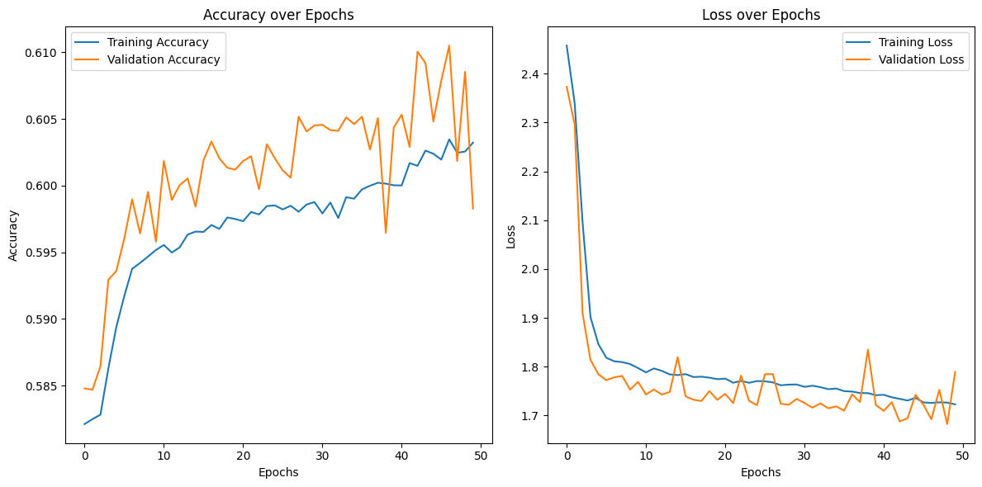
Select the best algorithm for the model with highest accuracy
First Model
Second Model
Test Accuracy: 76.05%
Test Accuracy: 60.00%

Slide 40
Completion and future
Completed
Collect temporal sensor data and visual data inputs.
Develop LSTM model for temporal sensor data.
Future Implementations
Develop CNN for visual inputs
Data analysis and report generation.

Slide 41
References
A. Alamri, A. Gumaei, M. Al-Rakhami, M. M. Hassan, M. Alhussein and G. Fortino, "An Effective Bio-Signal-Based Driver Behavior Monitoring System Using a Generalized Deep Learning Approach," in IEEE Access, vol. 8, pp. 135037-135049, 2020, doi: 10.1109/ACCESS.2020.3011003.
Qu, Fangming & Dang, Nolan & Furht, Borko & Nojoumian, Mehrdad. (2024). Comprehensive study of driver behavior monitoring systems using computer vision and machine learning techniques. Journal of Big Data. 11. 10.1186/s40537-024-00890-0.
H. -B. Kang, "Various Approaches for Driver and Driving Behavior Monitoring: A Review," 2013 IEEE International Conference on Computer Vision Workshops, Sydney, NSW, Australia, 2013, pp. 616-623, doi: 10.1109/ICCVW.2013.85. keywords: {Vehicles;Feature extraction;Monitoring;Accidents;Visualization;Head;Wheels;Driver drowsiness monitoring;Driving behavior monitoring;Unsafe driving behavior prediction},
V. Sanjay Kumar, S. Nair Ashish, I.V. Gowtham, S.P. Ashwin Balaji, E. Prabhu, Smart driver assistance system using raspberry pi and sensor networks, Microprocessors and Microsystems, Volume 79, 2020, 103275, ISSN 0141-9331,
Sameer Rafee, Xu Yun, Zhang Jian Xin and Zaid Yemeni, “Eye-movement Analysis and Prediction using Deep Learning Techniques and Kalman Filter” International Journal of Advanced Computer Science and Applications(IJACSA), 13(4), 2022. http://dx.doi.org/10.14569/IJACSA.2022.01304107

Slide 42

Iroshan G.H.M
IT21229084
Software Engineering
IT21229084 | Iroshan G.H.M | 24-25J-132

Slide 43

Integrated Emergency Support System for Deaf Drivers
IT21229084 | Iroshan G.H.M | 24-25J-132

Slide 44
Innovative Solution The "Integrated Emergency Support System for Deaf Drivers" combines real-time location tracking, predefined emergency texts, and text-to-speech conversion for effective communication during emergencies.
Automated Call Feature: The system automatically initiates calls to emergency services, converting text to speech to relay clear information about the driver's situation and location.
Enhanced Safety: Designed to be user-friendly, this system enhances safety by providing deaf drivers with a reliable method to alert and communicate with emergency responders.
IT21229084 | Iroshan G.H.M | 24-25J-132

Slide 45


Deaf drivers face challenges in communicating effectively with emergency services.
Delays in communication can increase safety risks during critical situations.
Existing solutions are often inadequate or too slow, failing to provide clear, real-time assistance.
A lack of accessible systems hinders timely responses for deaf drivers.
IT21229084 | Iroshan G.H.M | 24-25J-132

Slide 46

How can deaf drivers share emergency details effectively without spoken communication?
What delays do deaf drivers face in getting help during emergencies?
How do stressful situations worsen communication barriers for deaf drivers?
What gaps exist in current methods used by deaf individuals during emergencies?
IT21229084 | Iroshan G.H.M | 24-25J-132

Slide 47



Specific Objective
Sub Objective
To develop an Integrated Emergency Support System for deaf drivers, enabling efficient and accessible communication with emergency services using real-time Speech-to-Text (STT) and Text-to-Speech (TTS) technologies.
Communication Facilitation
Location Sharing
User-Friendly Design
Offline Capability
IT21229084 | Iroshan G.H.M | 24-25J-132

Slide 48


Data collection

Slide 49



System Overview
1
User Type Text
Receiver message
Deaf User
App
12
2
11
3
Convert To Text
TTS Model
Convert To Audio
STT Model
9
5
8
10
4
Telecom API
NLP Understanding
NLP Understanding
6
7
Receiver

Slide 50


Visualize the data
Transcriptions

Slide 51


Model
Pre - processing

Slide 52



Wireframes

Slide 53





Slide 54

Emergency Communication - Initiate requests, select emergency type, and share location.
Two-Way Communication - Real-time Speech-to Text (STT) and Text-to-Speech (TTS).
Predefined Messages - Quick templates for emergencies.
Chat Interface: Live transcription and messaging during calls.
Usability - Simple, accessible interface.
Reliability - Offline functionality in low-connectivity areas.
Performance - Low-latency STT/TTS processing.
Privacy - Secure handling of user data.
IT21229084 | Iroshan G.H.M | 24-25J-132

Slide 55
[1] Buzzi, M. C., et al. "A Comprehensive Survey of Enabling Technologies for Deaf People." Journal of Ambient Intelligence and Smart Environments 10.6 (2018): 497-518. https://doi.org/10.1016/j.jatar.2023.04.015.
[2] Jaiswal, D., et al. "Assistive Technology for Deaf: A Systematic Literature Review." Universal Access in the Information Society 20 (2021): 333-356. https://link.springer.com/article/10.1007/s10209-020-00762-1.
[3] Palanisamy, B., et al. "Mobile Computing: Challenges in Real-Time Location-Based Service and Solutions." IEEE Communications Surveys & Tutorials 15.1 (2013): 443-461. https://ieeexplore.ieee.org/document/6232247.
[4] Chen, L., et al. "A Survey of Sensing and Localization in Internet of Things for Smart Cities." IEEE Internet of Things Journal 7.1 (2020): 9-27.
https://ieeexplore.ieee.org/document/8771450.
[5] Fang, H., et al. "Recent Advances in Deep Learning for Speech Synthesis: A Survey." IEEE/ACM Transactions on Audio, Speech, and Language Processing 27.8 (2019): 1282-1304. https://ieeexplore.ieee.org/document/8707065.
[6] Buzzi, M. C., Leporini, B., & Akhter, F. "Assistive Technology for Deaf and Hard of Hearing People: Real Time Text and Sign Language." Proceedings of the 16th International ACM SIGACCESS Conference on Computers & Accessibility (2014): 263-264. https://www.sciencedirect.com/science/article/pii/S1084804516300652
IT21229084 | Iroshan G.H.M | 24-25J-132
Notes:
L

